Slide 1

INTERNSHIP STUDIO ETHICAL HACKING INTERNSHIP
ETHICAL HACKING
PROJECT REPORT BY
CH DURGA PRASAD
UNDER THE GUIDENCE OF ETHICAL HACKING INTERNSHIP

Slide 2
Task - 1

Slide 3
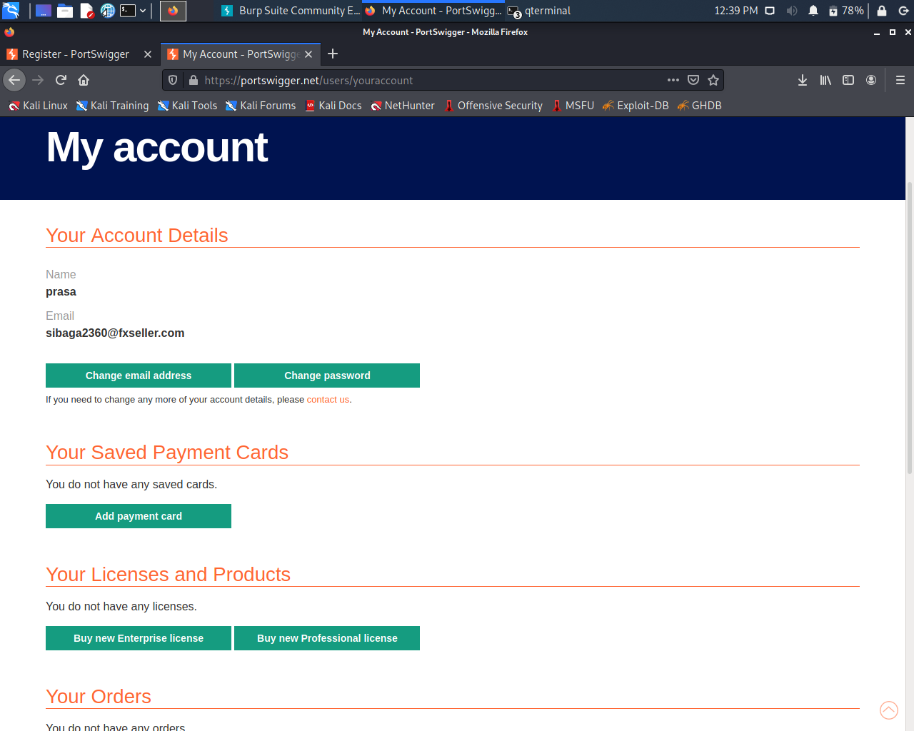
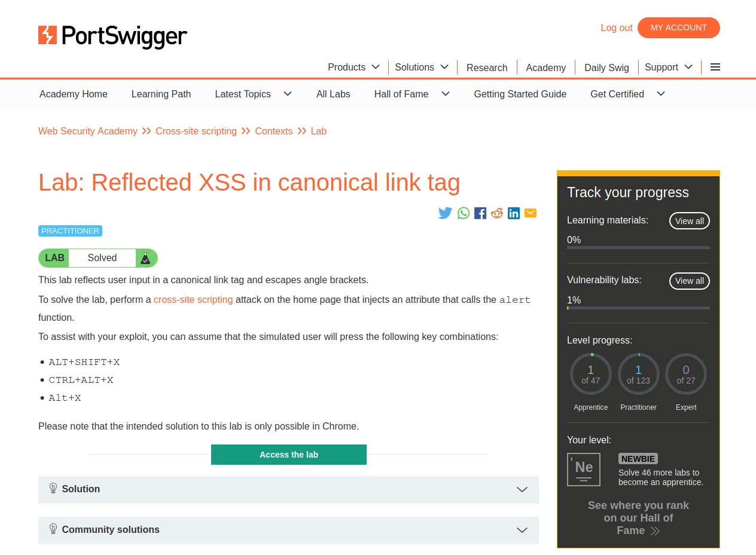
TASK 1 : SOLVED LABS USING TEMP-MAIL TO HIDE IDENTITY AND MADE A LOGIN ACCOUNT IN PPORTSWIGGER
LAB 1:
REFLECTED XSS IN CANONICAL LINK TAG

Slide 4
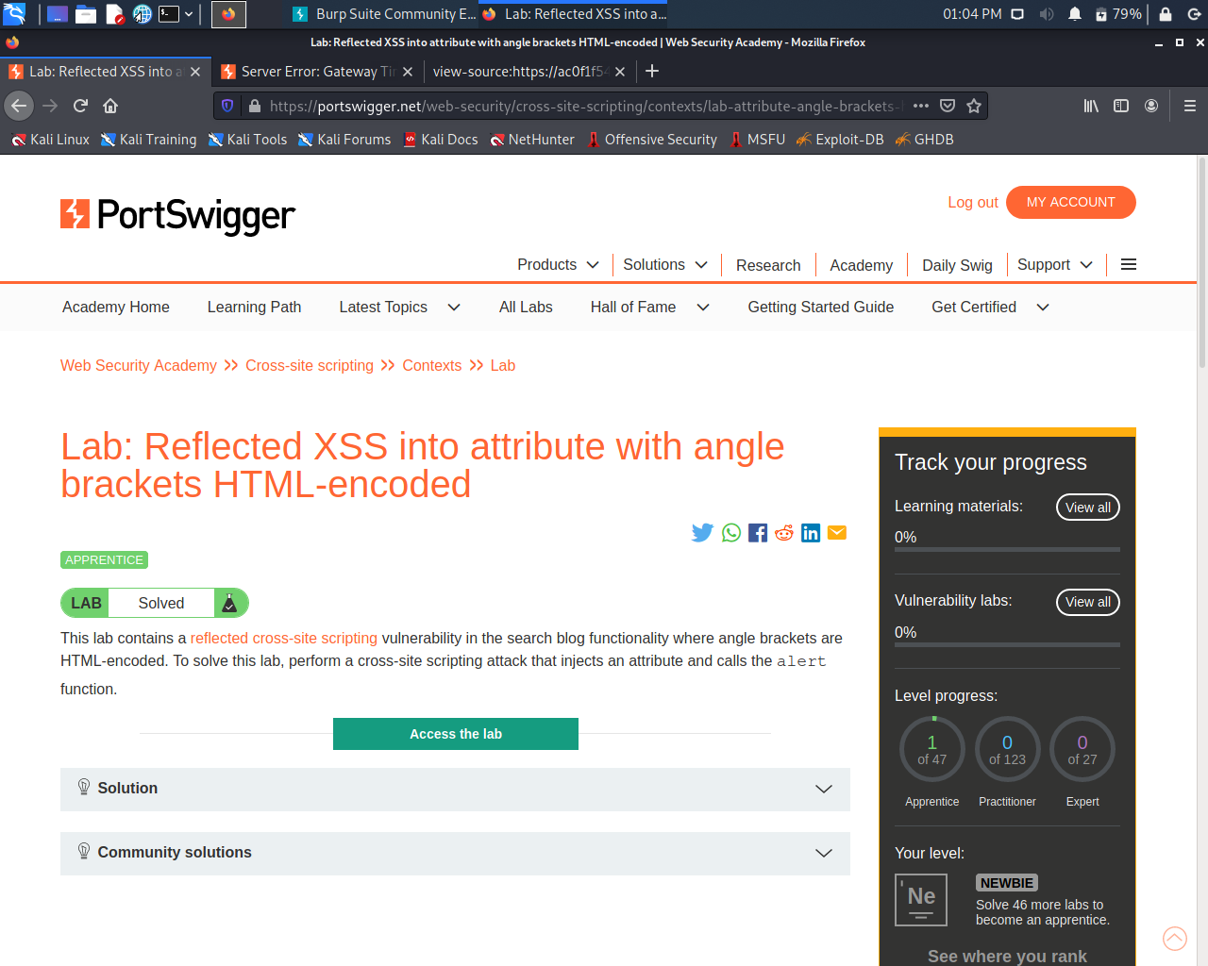
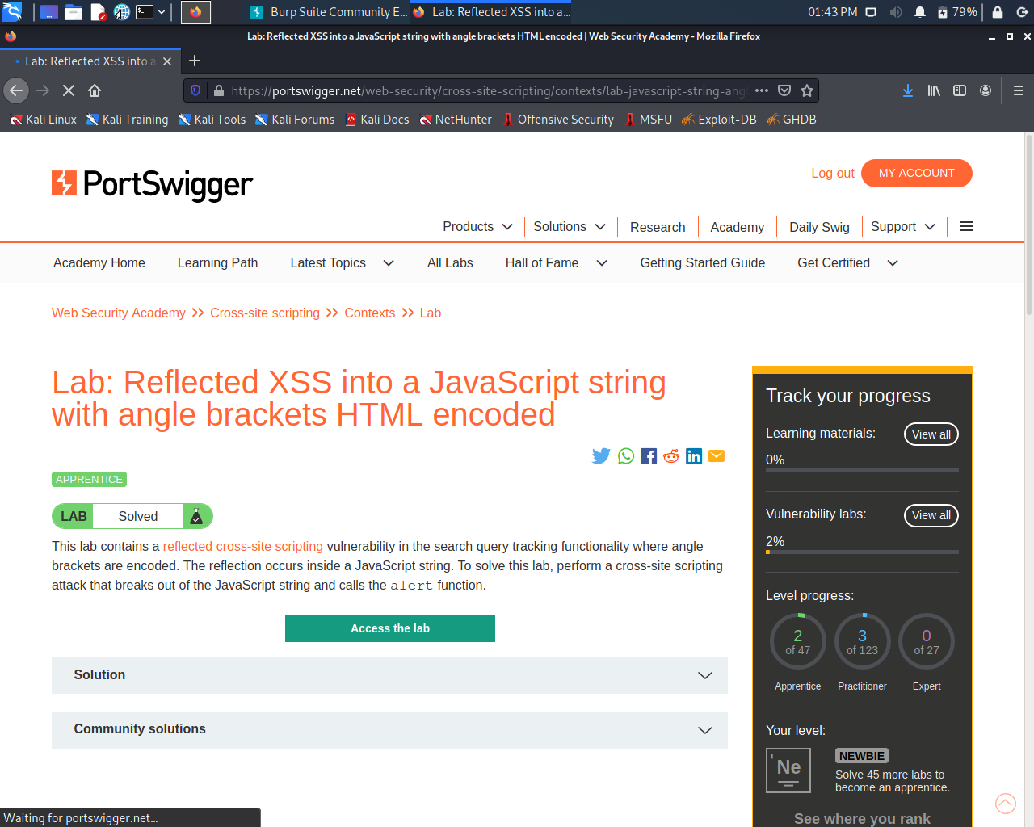
LAB 2: REFLECTED XSS INTO ATTRIBUTE WITH ANGLE BRACKETS HTML -ENCODED
LAB 3 :
REFLECTED XSS INTO A JAVASCRIPT STRING WITH ANGLE BRACKETS HTML ENCODED

Slide 5
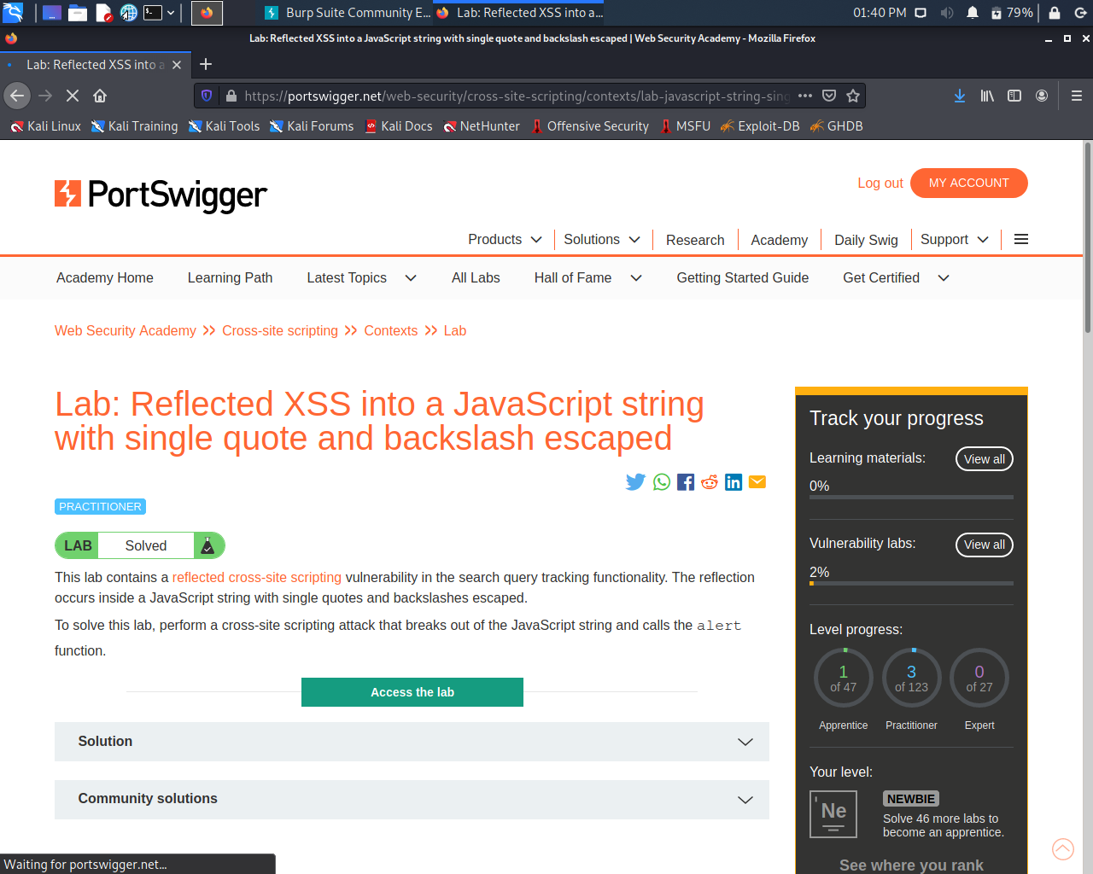
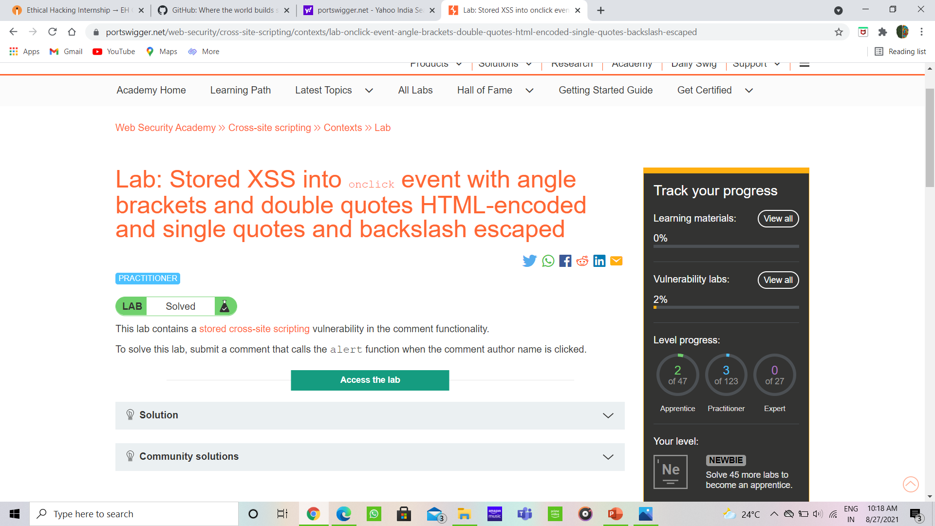
LAB 4: REFLECTED XSS INTO A JAVA SCRIPT STRING WITH SINGLE QUOTE AND BLACKSLASH ESCAPED
LAB 5 :
STORED XSS INTO ONCLICK EVENT ANGLE BRACKETS AND DOUBLE QUOTES HTML ENCODED AND SINGLE QUOTES AND BACKSLASH ESCAPED

Slide 6
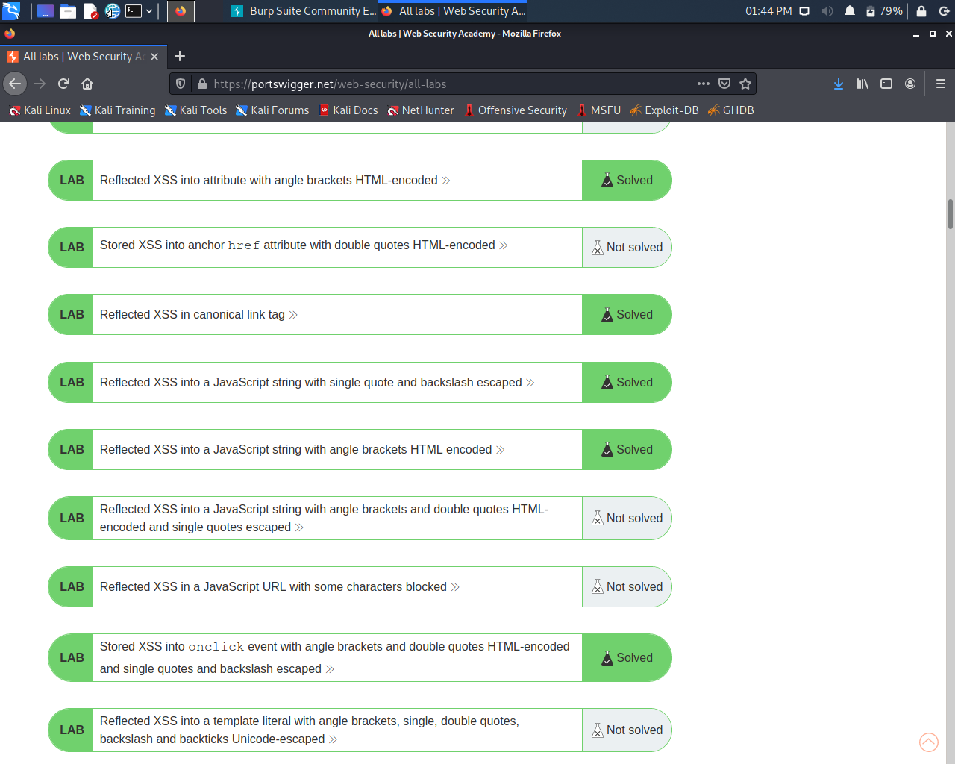
SOLVED LABS LIST

Slide 7
task - 2

Slide 8
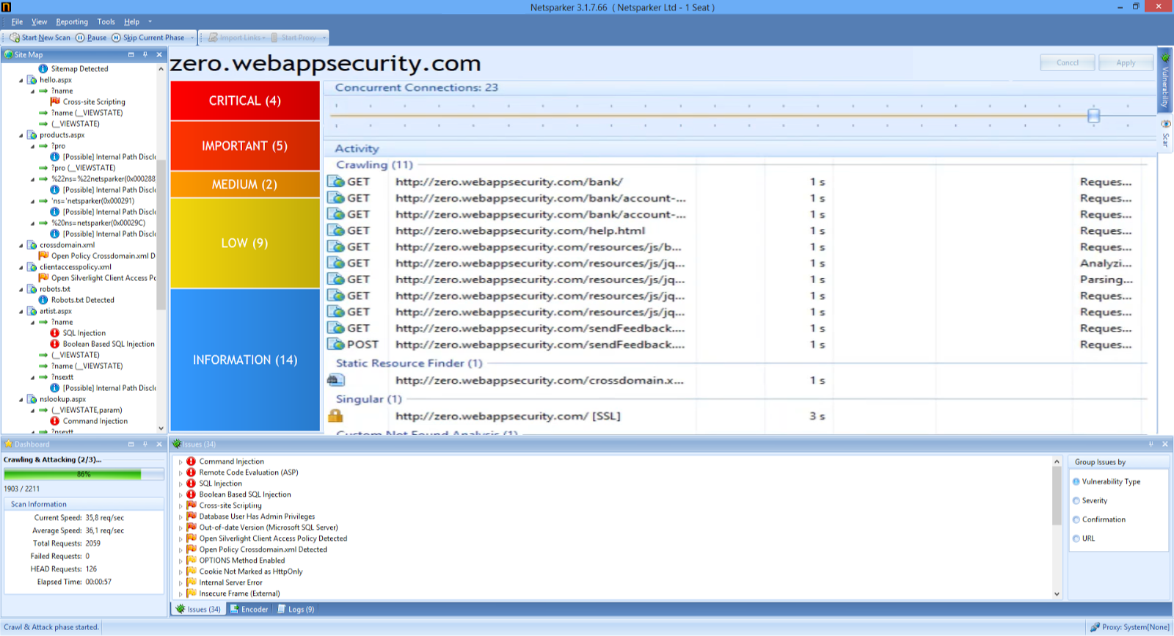
TASK 2 : I had found 4 critical vulnerabilities on the webpage zero.webappsecurity.com which will be explained in next slide

Slide 9
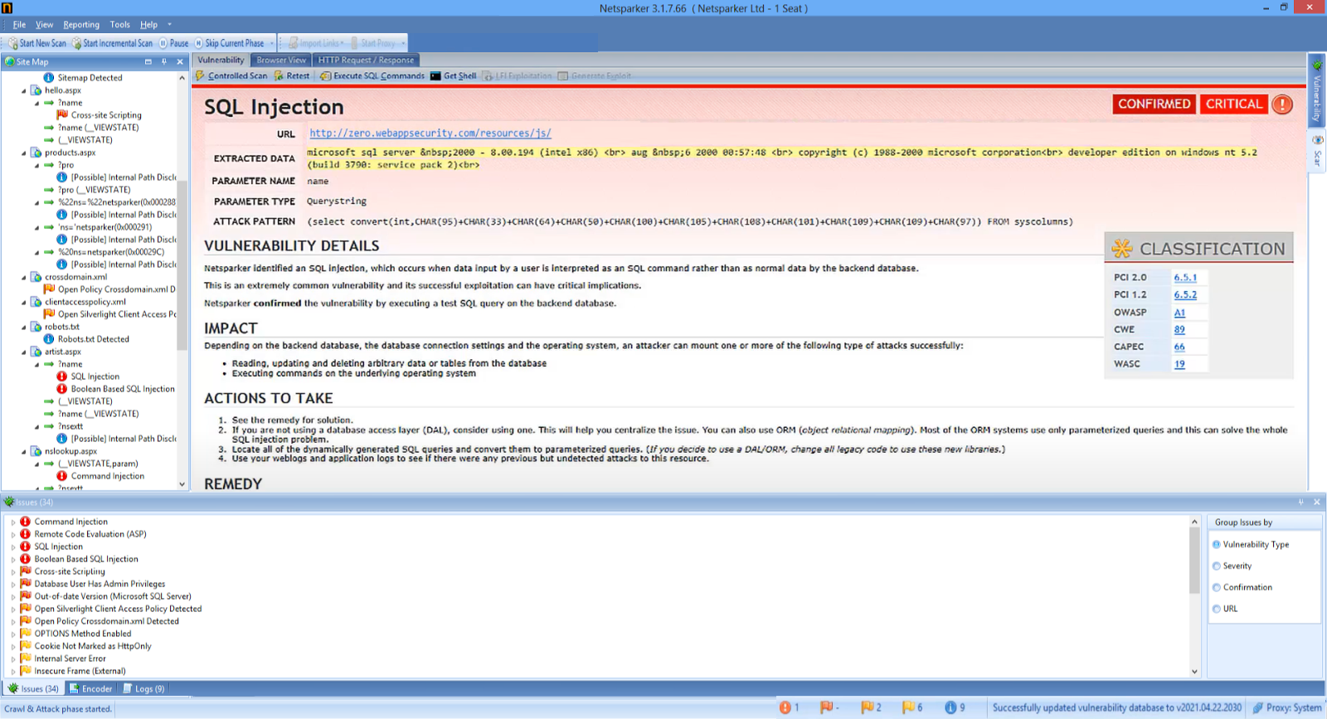
VULNERABILITY DETAILS : The Netsparker Identified That The Zero.Webappsecurity.Com Has A Sql Injuction Which Is Done By Using Automatic Vulnerability Scanner,the Web Page Has A Flaw By Which An Hacker Send Simple Sql Command To Use The Vulnerability To Access Data Base Of Your Banking Portal. IMPACT : Due To This Type Of Vulnerability An Hacker Can Access The Database And Also Manuplate The Information That Is Present On The Portal And He Can Also Mount Many Attacks To Perform He Can Read Data ,Write ,And Delete Data On The Data Base REMEDY : Try To Solve The Problem As Soon As Possible (Try To Locate All Of The Dynamically Generated Sql Quries To Parameterized Quries) If Not You Will Be In Danger I.E Data Breach

Slide 10
Task - 3

Slide 11
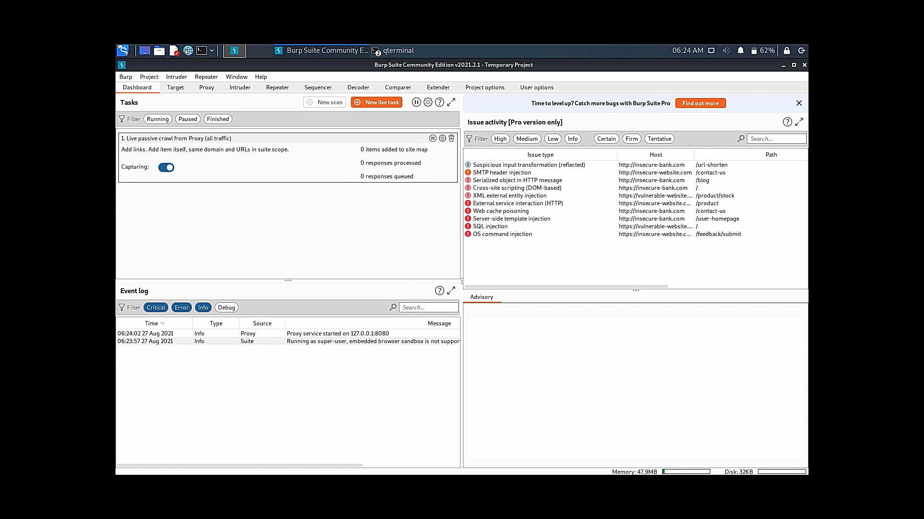
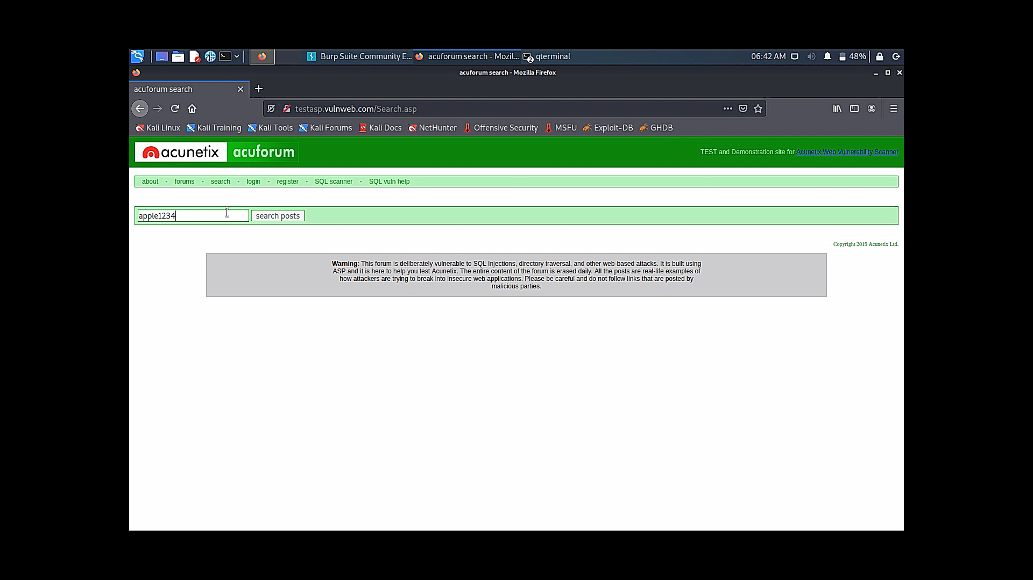
TITLE : CROSS SITE SCRIPTING(XSS) DOMAIN : VULWEB.COM SUBDOMAIN : TESTASP.VULWEB.COM THEORY: The Ppt Is About The Vulnerability Which Was Found By Xss On Http://Testasp.Vulweb.Com Webpage. It Has Different Xss Vulnerability Which Will Be Explained Step By Step And Also Procedure To Find These Vulnerabilitys Using Brup Suite Application And Alos We Provide A Video About This Process. STEPS TO REPRODUCE : STEP 1 : Open the brup suite and start the new project and go to proxy and make intercept off STEP 2 : visit the Http://Testasp.Vulweb.Com and search of search bar ,now on the intercept on. Search “object1234”

Slide 12
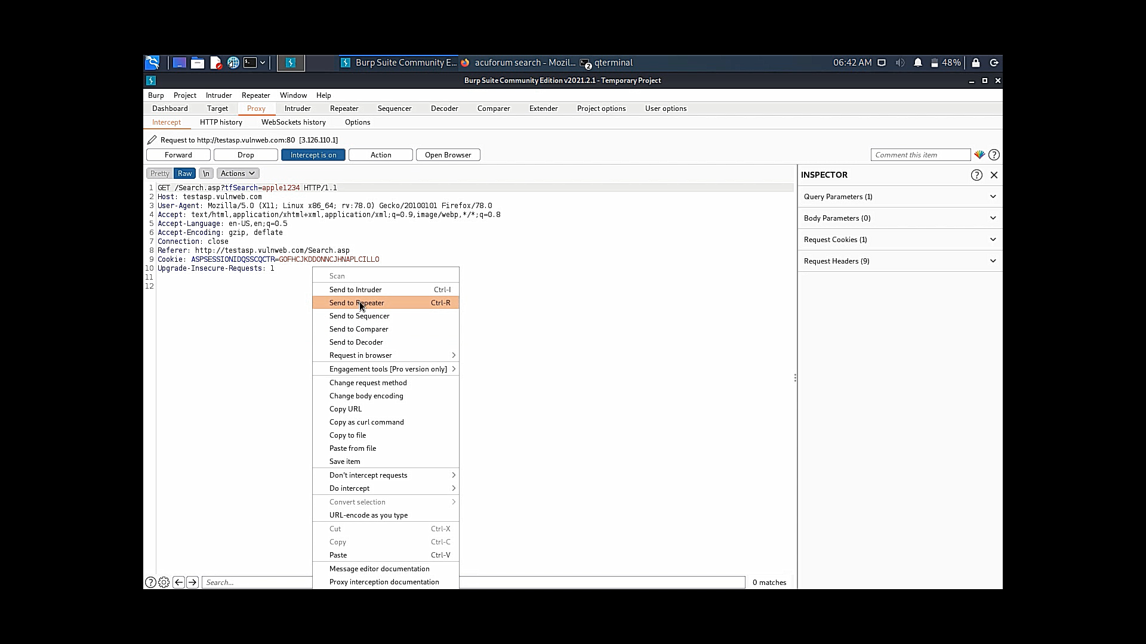
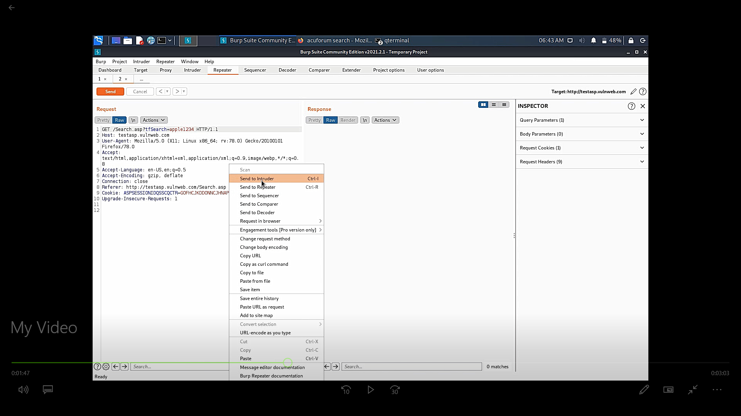
Step 3 : Now you can see an request will arrive ,send it to repeater and off the intercept to off step 4 : Now as shown in figure from repeater send it to intruder

Slide 13
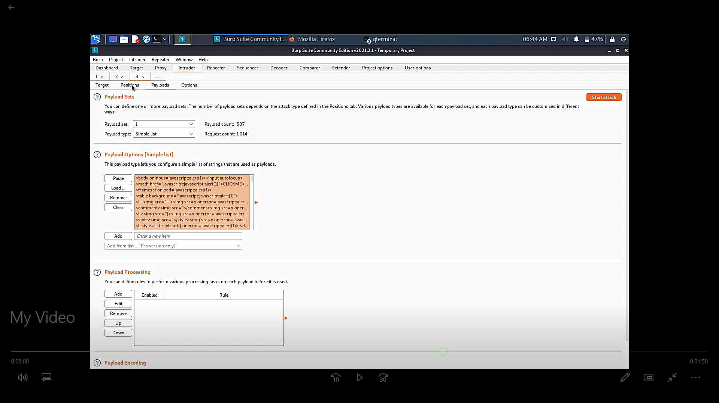
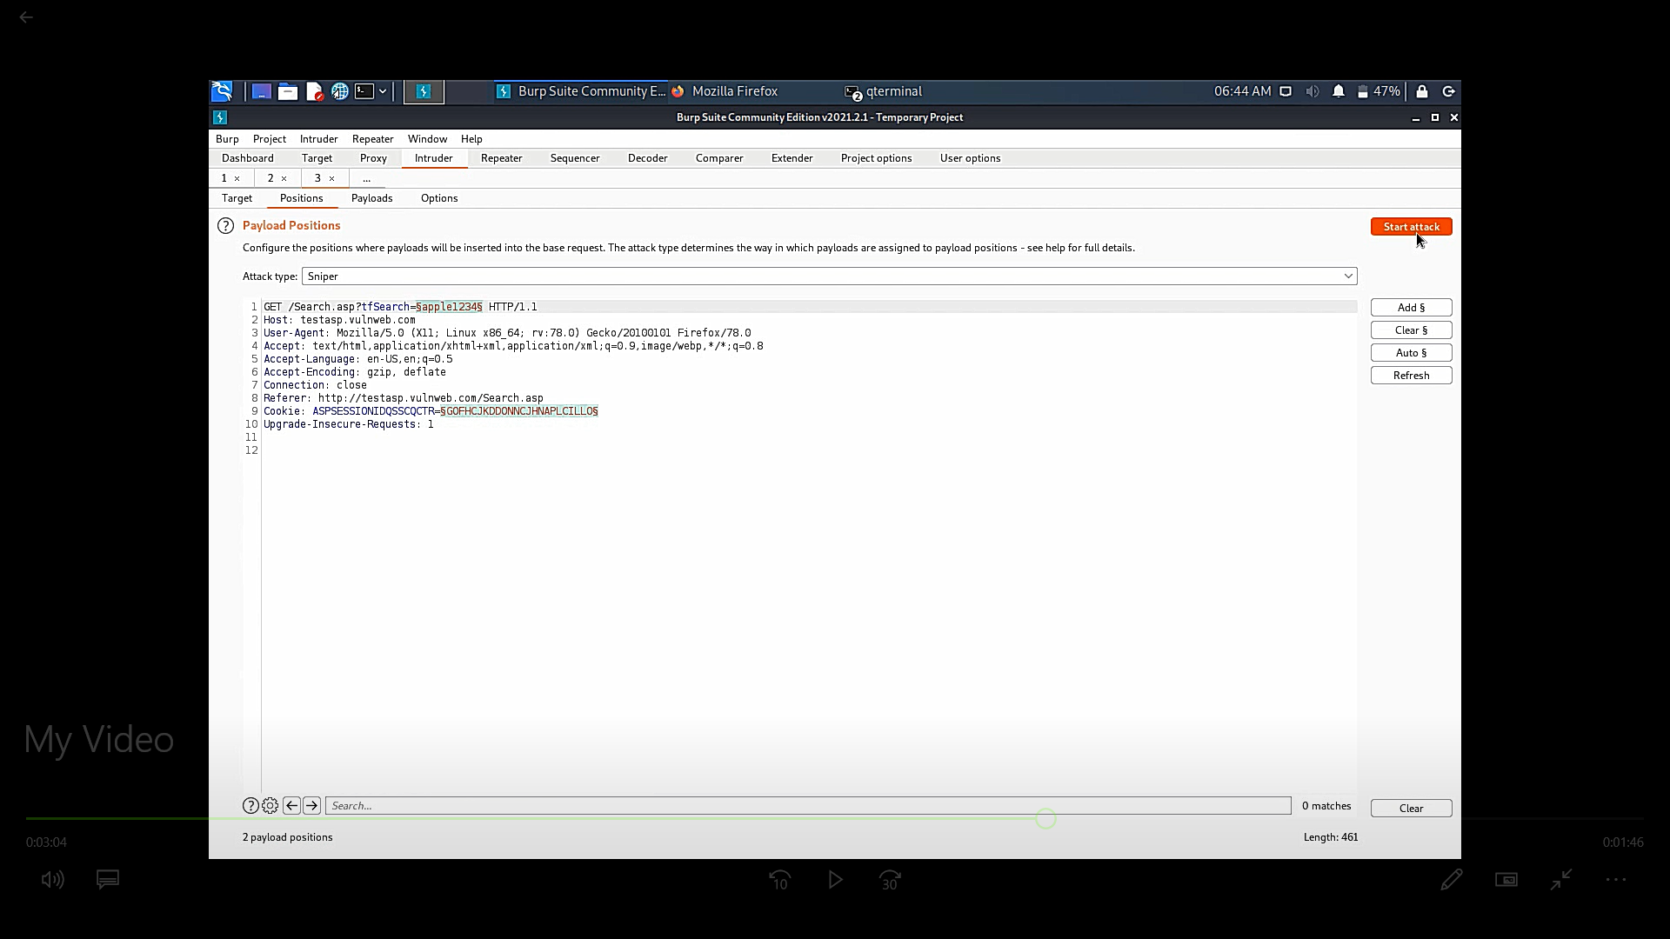
Step 5 : Now go to intruder , select payloads and load with some payloads you have or from web as shown in fig . Step 6 : Now check all the necessary needs, and start the attack as shown in fig. it will take some time to process the attacks and gives you results.

Slide 14
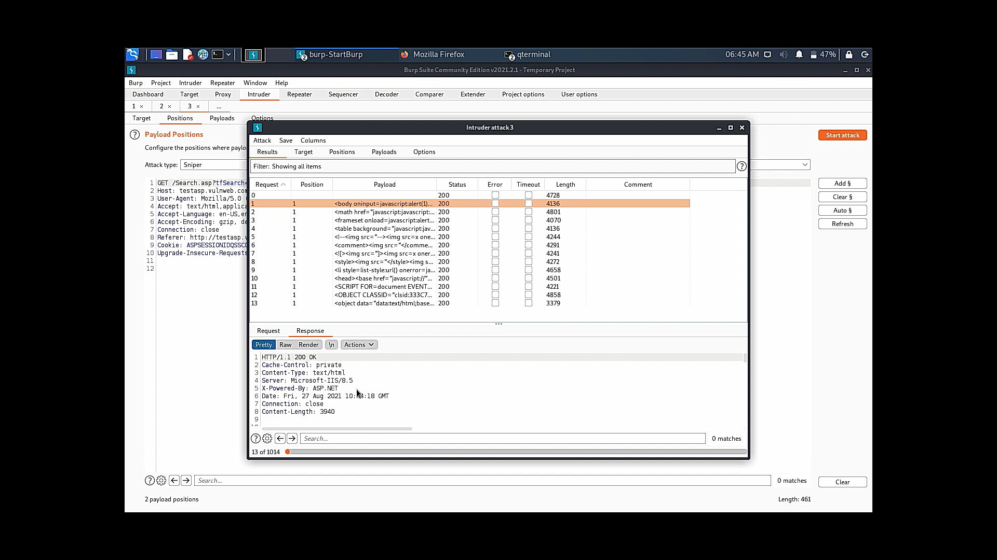
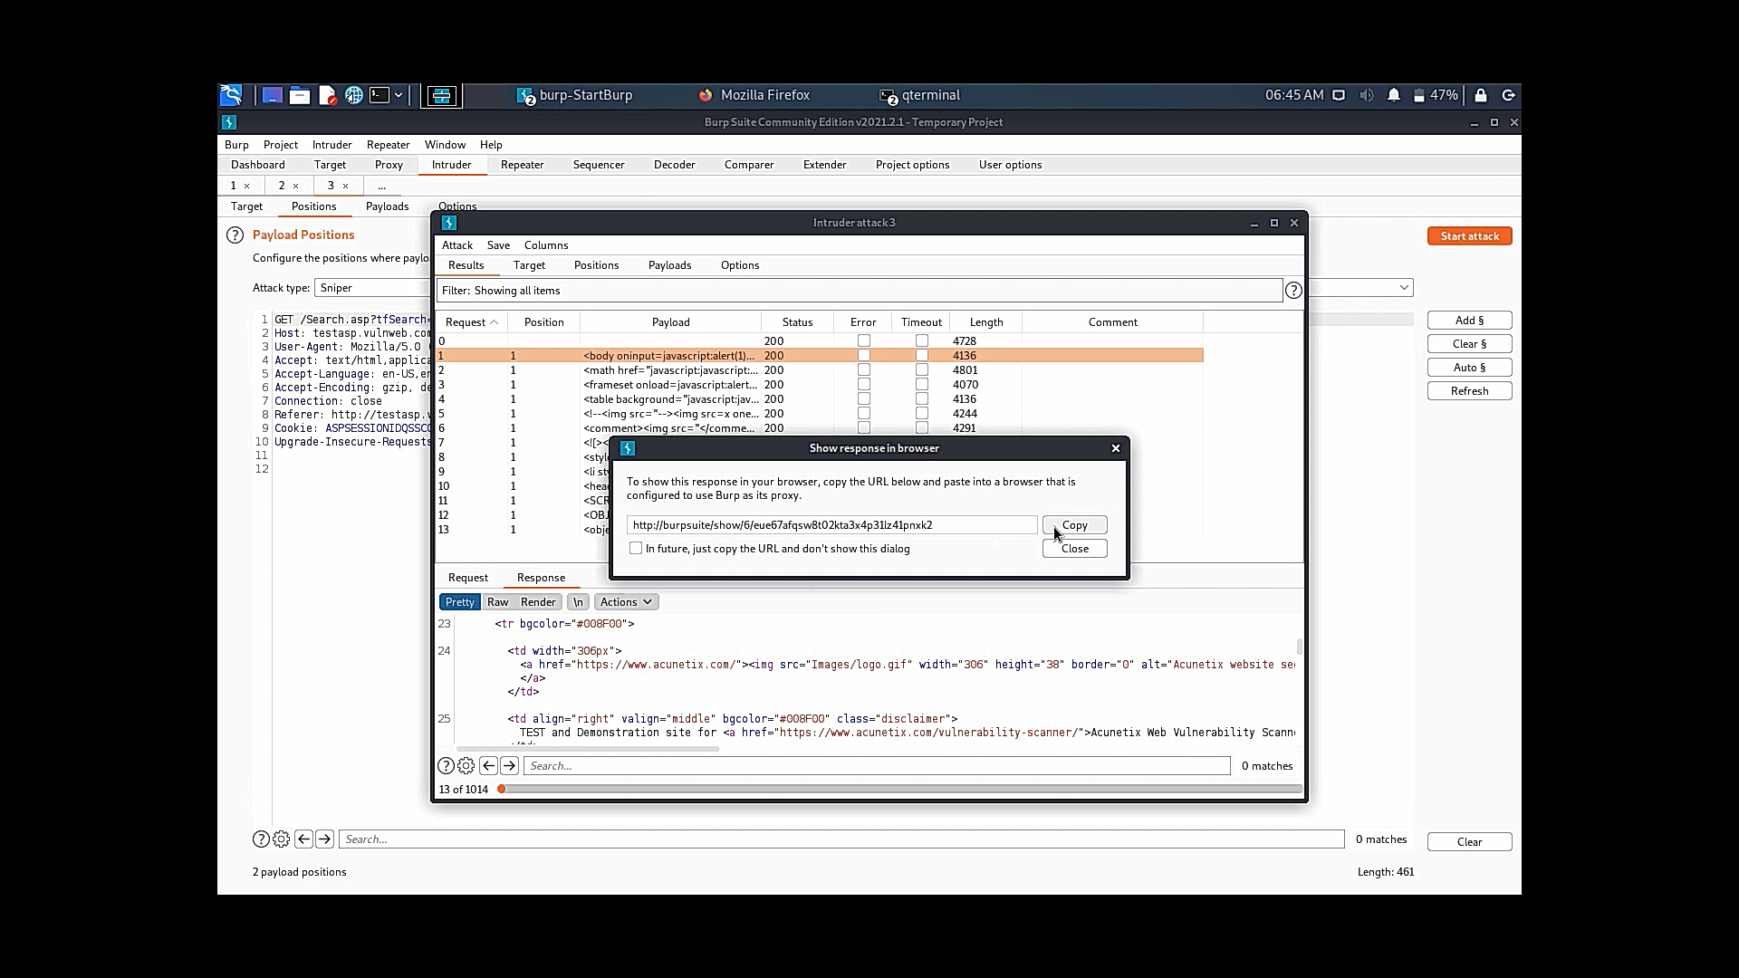
Step 7 : you can see some vulnerabilitys which are found out by brupsuite using different type of payloads as shown in fig. step 8 : after finding a suitable payload go to response an click on search response on browser ,copy the link provided by brupsuite as shown fig and visit the link and you will get result and make analysis of the result of this payload will be on next page.

Slide 15
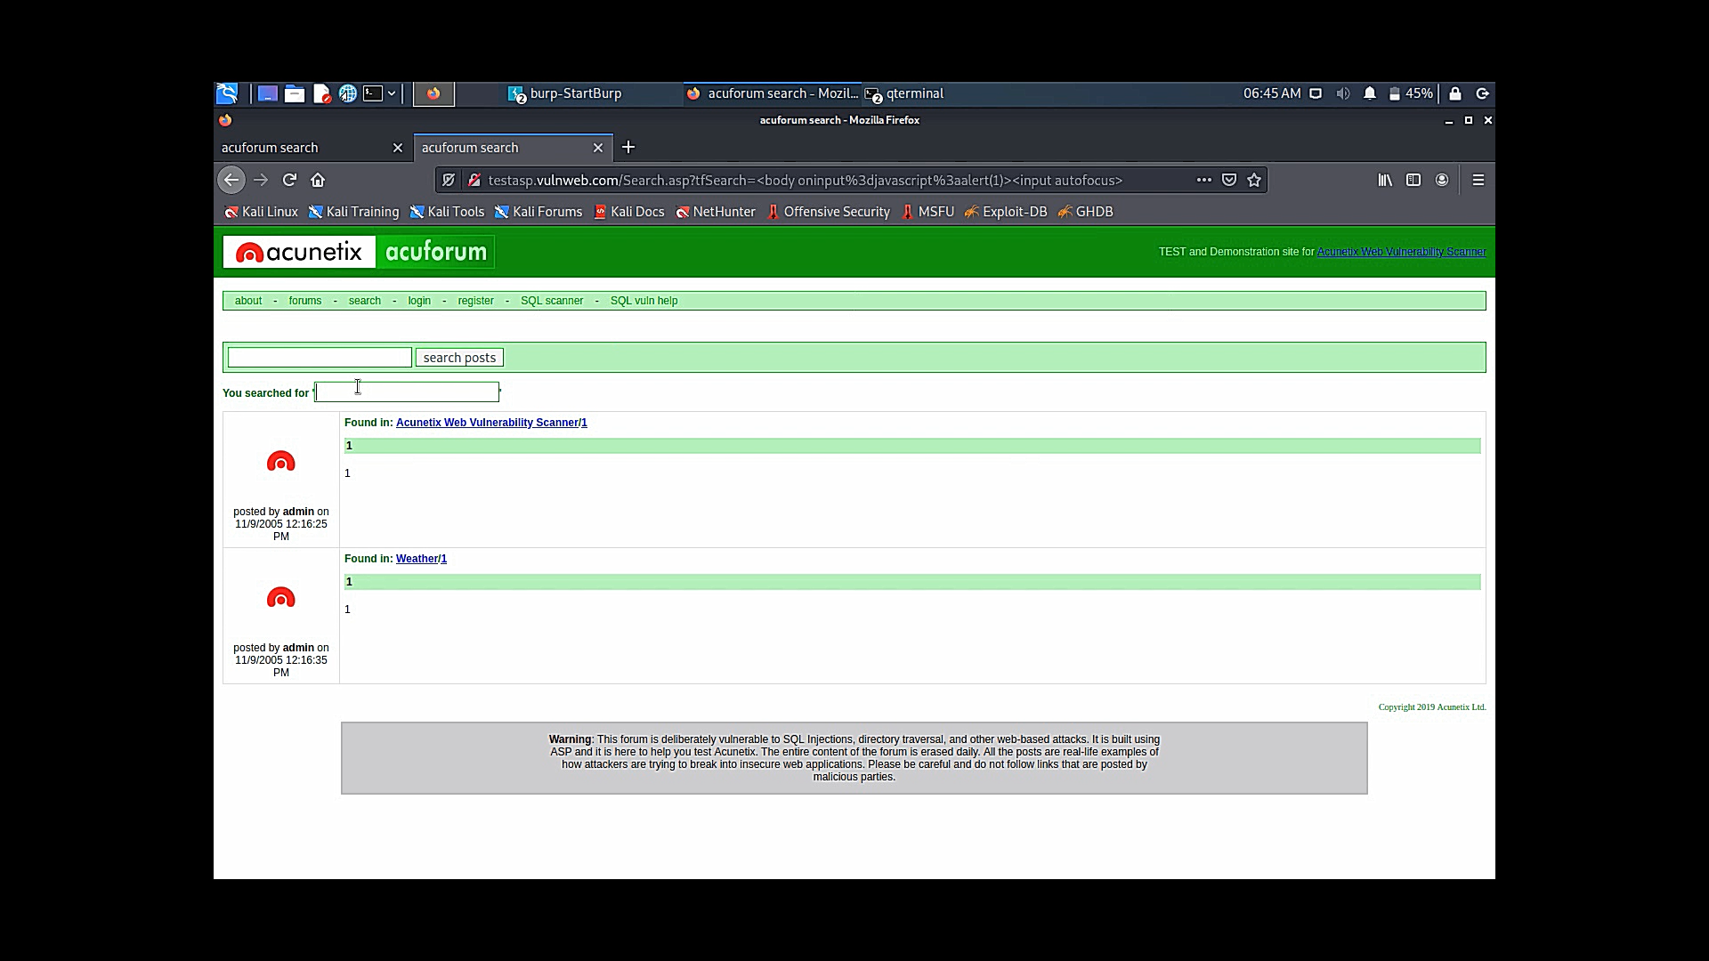
Result for payload(<body oninput=javascript:alert(1)><input autofocus>)

Slide 16
Impact : There is a issue with your website with xss payloads ,which changes the data on your webpage, which allows the hacker to get access to data base through backend and manuplate valuable data on your webpage mitigation : hello sir, as your web site contains vulnerabilities you have to take necessary action in order to avoid data breach or loss of data. To do so ,please make your database update up to date and make sure that, any of your devices running above. chrome browser > 10 edge browser > 9.0 firefox browser > 4.0 which are vulnerable for <body oninput=javascript:alert(1)><input autofocus> for this payload. thers are many xss payloads which can harm your webpage which is demonstrated in detailed in the video provided to you.
INTERNSHIP STUDIO
thankyou
BY
CH DURGA PRASAD

